Slide 1
Topic: Geometry and Mapping EQ: How can we use map scales to figure out real life distances?
Year 11 Mathematics Essentials

Slide 2
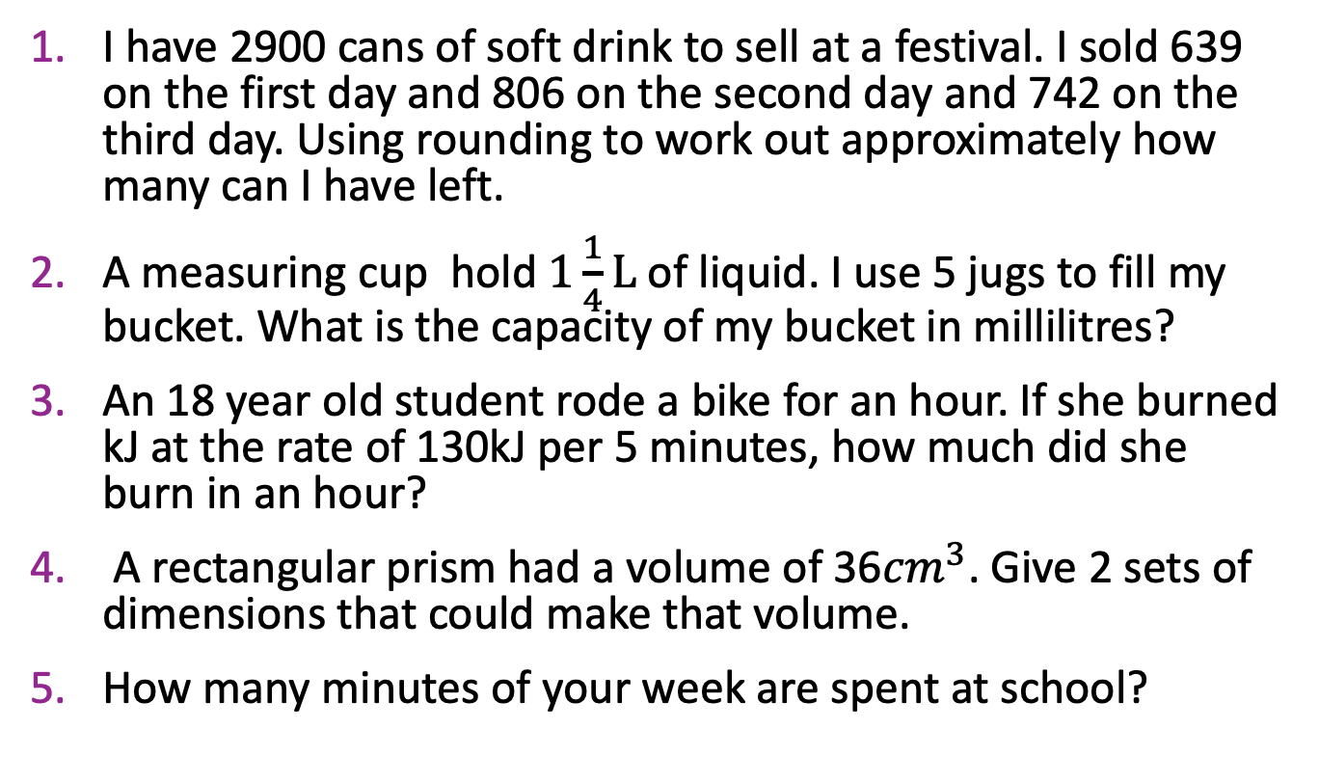
Five Questions
Topic: Geometry and Mapping
EQ – How can we apply our knowledge of scale ratios to figure out real life distances?
I have 2900 cans of soft drink to sell at a festival. I sold 639 on the first day and 806 on the second day and 742 on the third day. Using rounding to work out approximately how many can I have left.
A measuring cup hold $1\frac{1}{4}L$of liquid. I use 5 jugs to fill my bucket. What is the capacity of my bucket in millilitres?
An 18 year old student rode a bike for an hour. If she burned kJ at the rate of 130kJ per 5 minutes, how much did she burn in an hour?
A rectangular prism had a volume of 36${cm}^{3}$. Give 2 sets of dimensions that could make that volume.
How many minutes of your week are spent at school?
900 using rounding
6250mL
130kJ x 60 / 5 1560kJ
18 x 1 x 2 2 x 3 x 6
1800 minutes, assuming a 6 hour day 5 days a week.

Slide 3
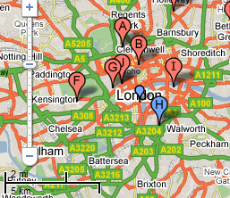
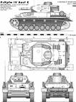

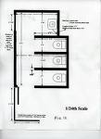
Think Pair Write Share
Topic: Geometry and Mapping
EQ – How can we apply our knowledge of scale ratios to figure out real life distances?
Write as many examples as you can, of where we would use a scale.
Vehicle design
Footprints of houses
Scale Drawings
On Maps
Notes:
Check in with students for their examples, go through the provided ones.

Slide 4
24
7
30
Date: XX/XX/2021
Topic: Geometry and Mapping
EQ – How can we apply our knowledge of scale ratios to figure out real life distances?
What information does scales provide?
Scale drawing allows us to draw large objects on a smaller scale while keeping them accurate.
All scale drawings must have a scale written on them. Scales are usually expressed as ratios (which we just learned about!).
Example: 1cm : 100cm
The ratio 1cm:100cm means that for every 1cm on the scale drawing the length will be 100cm in real life
WICOR

Slide 5
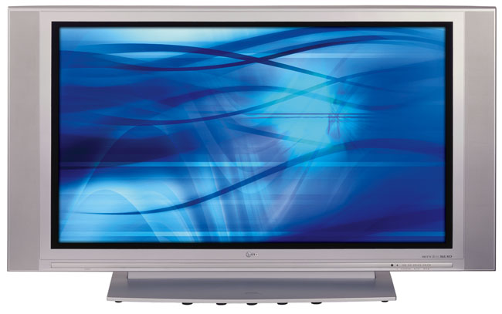
24
7
30
Date: XX/XX/2021
Topic: Geometry and Mapping
EQ – How can we apply our knowledge of scale ratios to figure out real life distances?
Example:
A scale of
1 cm = 2m
…means for every 1cm measured on a
drawing this represents 2m in real-life.
4cm
4x25= 100cm
2cm
2x25 = 50cm
WICOR
The scale of this drawing is 1cm = 25cm
What is the actual width and height of the TV ?

Slide 6
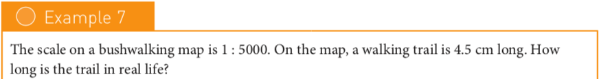
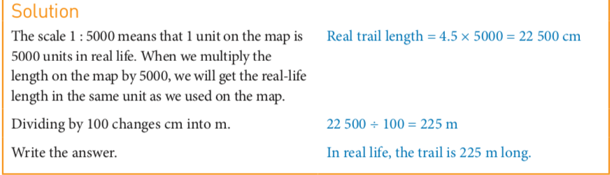
24
7
30
Date: XX/XX/2021
Topic: Geometry and Mapping
EQ – How can we apply our knowledge of scale ratios to figure out real life distances?
WICOR

Slide 7
TASK:
Complete the worksheet on converting ratios.

